Slide 1
Linear Regression with multiple variables

Slide 2
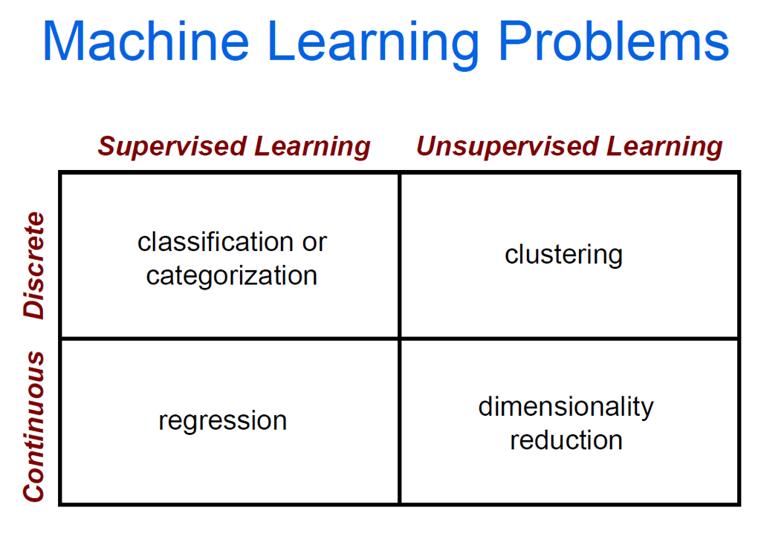
Where are we at?

Slide 3

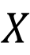
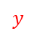
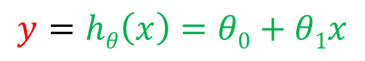
Recap from intro lecture to univariate linear regression – predicting the price of a house using only one feature (one independent variable)
$$X$$
$$y$$
Size (feet²) | Price ($1000)
2104 | 460
1416 | 232
1534 | 315
852 | 178
… | …
$$y$$
y
x
$$y=hθ\left(x\right)=θ0+θ1x$$

Slide 4
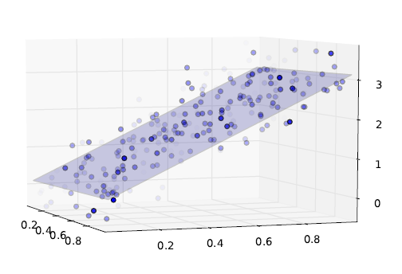
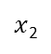
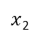
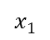
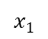
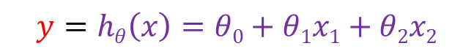

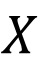
Bivariate linear regression – predicting the price of a house using two features (two independent variable)
$$X$$
$$y$$
Size (feet²) | Age of home (years) | Price ($1000)
2104 | 45 | 460
1416 | 40 | 232
1534 | 30 | 315
852 | 36 | 178
… | … | …
$$x1$$
$x$₂
$$y$$
$$y$$
$$y=hθ\left(x\right)=θ0+θ1x1+θ2x2$$
$x$₂
$$x1$$

Slide 5
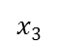
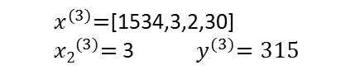
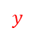
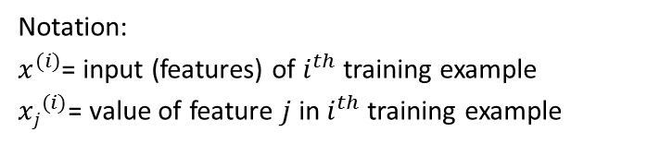
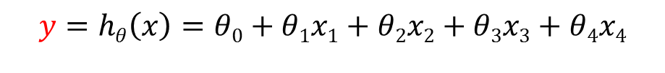
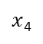
Multivariate linear regression – predicting the price of a house using several features (in this example, 4 independent variables)
$$X$$
$$y$$
Size (feet²) | Number of bedrooms | Number of floors | Age of home (years) | Price ($1000)
2104 | 5 | 1 | 45 | 460
1416 | 3 | 2 | 40 | 232
1534 | 3 | 2 | 30 | 315
852 | 2 | 1 | 36 | 178
… | … | … | … | …
$$x1$$
$x$₂
$$x3$$
$x$₄
$$y$$
$$y=hθ\left(x\right)=θ0+θ1x1+θ2x2+θ3x3+θ4x4$$
Notation:
$x^{(i)}$= input (features) of $i^{th}$ training example
${xj}^{(i)}$= value of feature $j$ in $i^{th}$ training example
${ x}^{(3)}=$[1534,3,2,30]
${ x2}^{(3)}=$ 3 ${ y}^{(3)}=315$

Slide 6
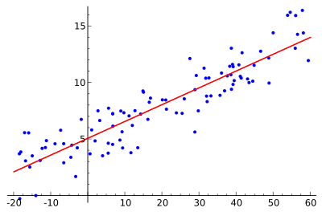
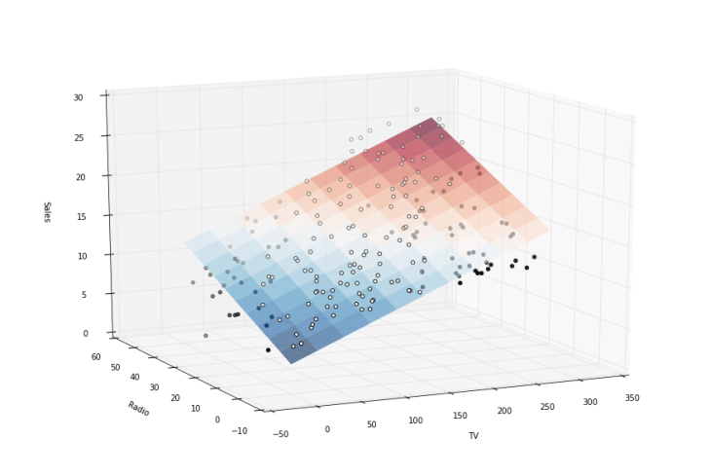
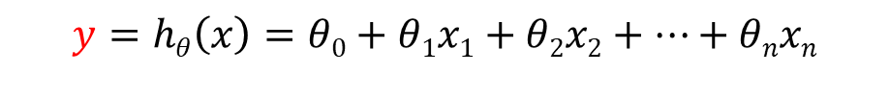
Hyperplanes
A hyperplane is a subspace of one dimension less than its ambient space
If a space is 3-dimensional then its hyperplanes are the 2-dimensional planes
If the space is 2-dimensional, its hyperplanes are the 1-dimensional lines
This notion can be used in any general space
A hyperplane can represent a linear regression model in high dimensional space in the same way that a line represents a model in 2 dimensions
Hyperplane
$$y=hθ\left(x\right)=θ0+θ1x1+θ2x2+…+θnxn$$
Line
$$y=hθ\left(x\right)=θ0+θ1x1$$

Slide 7
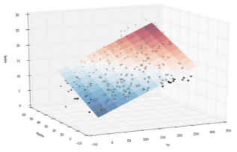
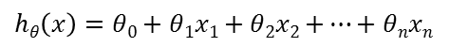
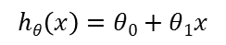
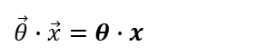
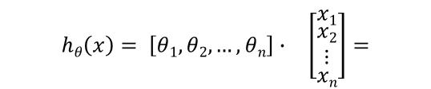
Hypothesis/Model representation
Univariate linear regression:
$$hθ\left(x\right)=θ0+θ1x$$
Multivariate linear regression:
$hθ\left(x\right)=θ0+θ1x1+θ2x2$ $+…+θnxn$
Shorthand notation for expressing a model/hypothesis using a dot product of vectors:
$$\begin{matrix}hθ\left(x\right)= \left[θ1,θ2,…,θn\right]∙ & \left[\begin{matrix}x1 \\ \begin{aligned}x2 \\ ⋮\end{aligned} \\ xn\end{matrix}\right]\end{matrix}=$$
$\vec{θ}$ $∙$ $\vec{x}=θ∙x$
Notice the bold notation to indicate that the variable represents a vector

Slide 8
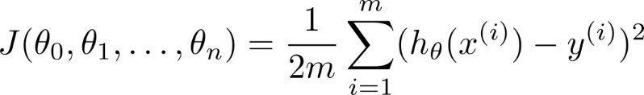

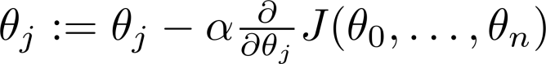
Hypothesis:
The task is to use training data $X$and a cost function $J(θ)$ to find the parameters$θ$ that define the hyperplane that better fits the data
Cost function:
J(θ₀,θ₁)
θ₁
θ₀
Gradient descent update rule:

Slide 9
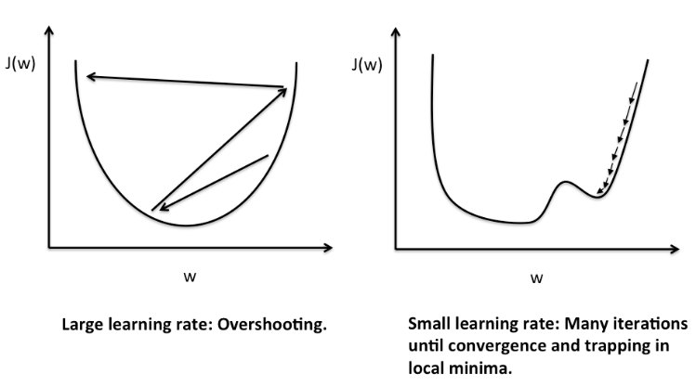
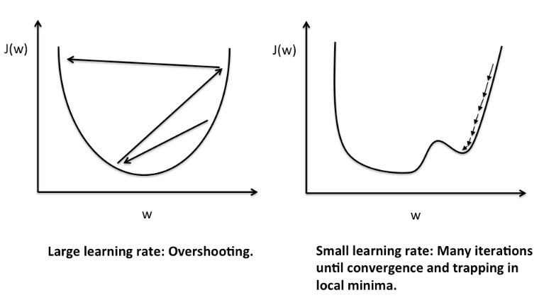
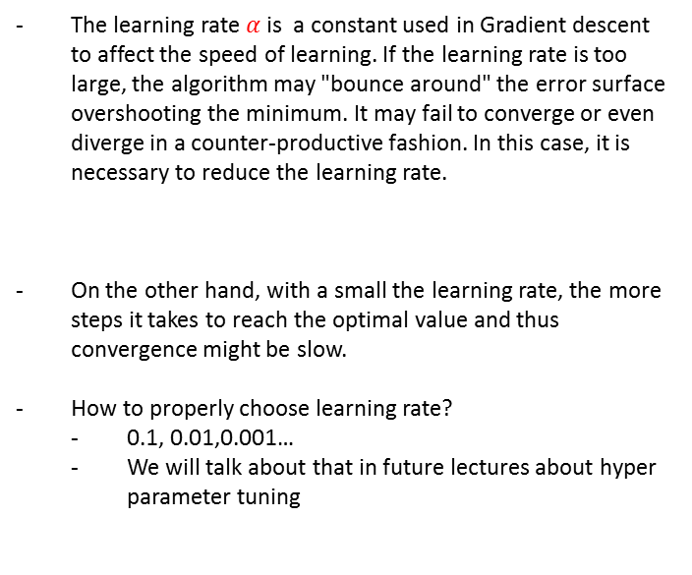
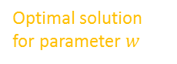

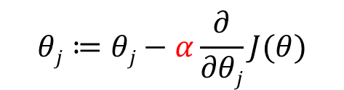
The learning rate $α$of Gradient descent
$$θj≔θj−α\frac{∂}{∂θj}J(θ)$$
Optimal solution for parameter $w$
The learning rate $α$ is a constant used in Gradient descent to affect the speed of learning. If the learning rate is too large, the algorithm may "bounce around" the error surface overshooting the minimum. It may fail to converge or even diverge in a counter-productive fashion. In this case, it is necessary to reduce the learning rate.
On the other hand, with a small the learning rate, the more steps it takes to reach the optimal value and thus convergence might be slow.
How to properly choose learning rate?
0.1, 0.01,0.001…
We will talk about that in future lectures about hyper parameter tuning

Slide 10
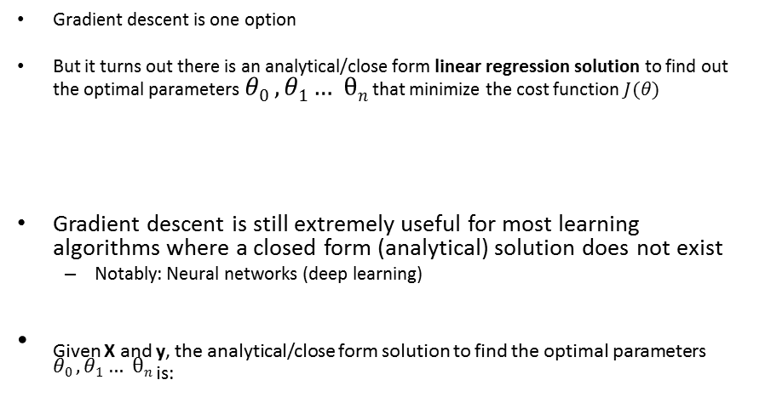
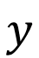
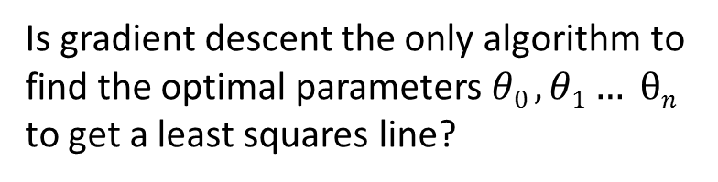
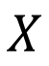
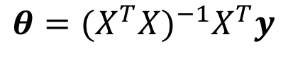
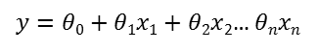
Is gradient descent the only algorithm to find the optimal parameters$θ0 ,θ1… θn$ to get a least squares line?
Gradient descent is one option
But it turns out there is an analytical/close form linear regression solution to find out the optimal parameters $θ0 ,θ1… θn$ that minimize the cost function $J(θ)$
Gradient descent is still extremely useful for most learning algorithms where a closed form (analytical) solution does not exist
Notably: Neural networks (deep learning)
Given X and y, the analytical/close form solution to find the optimal parameters $θ0 ,θ1… θn$ _{is:}
$$X$$
$$y$$
$y=θ0+θ1x1+θ2x$₂… $θnxn$
$$θ={{(X}^{T}X)}^{−1}X^{T}y$$

Slide 11
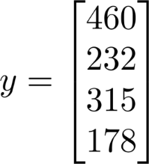
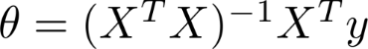
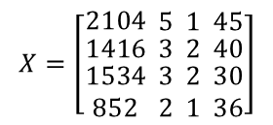
Minimization of cost function analytically
Size (feet²) | Number of bedrooms | Number of floors | Age of home (years) | Price ($1000)
2104 | 5 | 1 | 45 | 460
1416 | 3 | 2 | 40 | 232
1534 | 3 | 2 | 30 | 315
852 | 2 | 1 | 36 | 178
$$X=\left[\begin{matrix}2104 \\ \begin{matrix}1416 \\ \begin{matrix}1534 \\ 852\end{matrix}\end{matrix}\end{matrix} \begin{matrix}5 \\ \begin{matrix}3 \\ \begin{matrix}3 \\ 2\end{matrix}\end{matrix}\end{matrix} \begin{matrix}1 \\ \begin{matrix}2 \\ \begin{matrix}2 \\ 1\end{matrix}\end{matrix}\end{matrix} \begin{matrix}45 \\ \begin{matrix}40 \\ \begin{matrix}30 \\ 36\end{matrix}\end{matrix}\end{matrix}\right]$$
Normal equation:

Slide 12
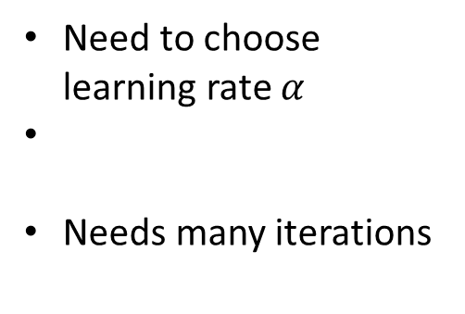
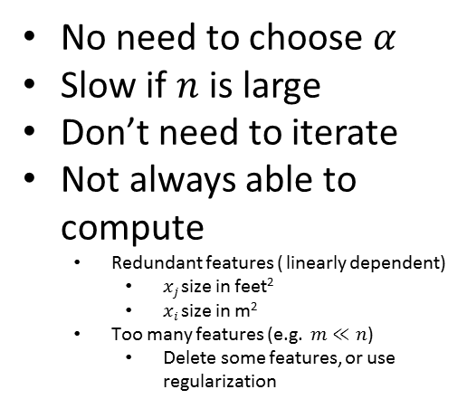
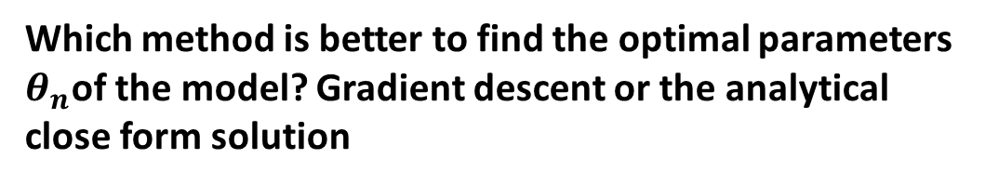
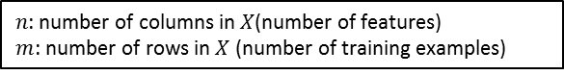
Which method is better to find the optimal parameters $θ_{n}$of the model? Gradient descent or the analytical close form solution
Gradient Descent
Analytical Equation
Need to choose learning rate $α$
Needs many iterations
No need to choose $α$
Slow if $n$ is large
Don’t need to iterate
Not always able to compute
Redundant features ( linearly dependent)
$xj$size in feet²
$xi$size in m²
Too many features (e.g. $m≪n$)
Delete some features, or use regularization
Works well even when is large.
$n$: number of columns in $X$(number of features)
$m$: number of rows in $X$ (number of training examples)

Slide 13
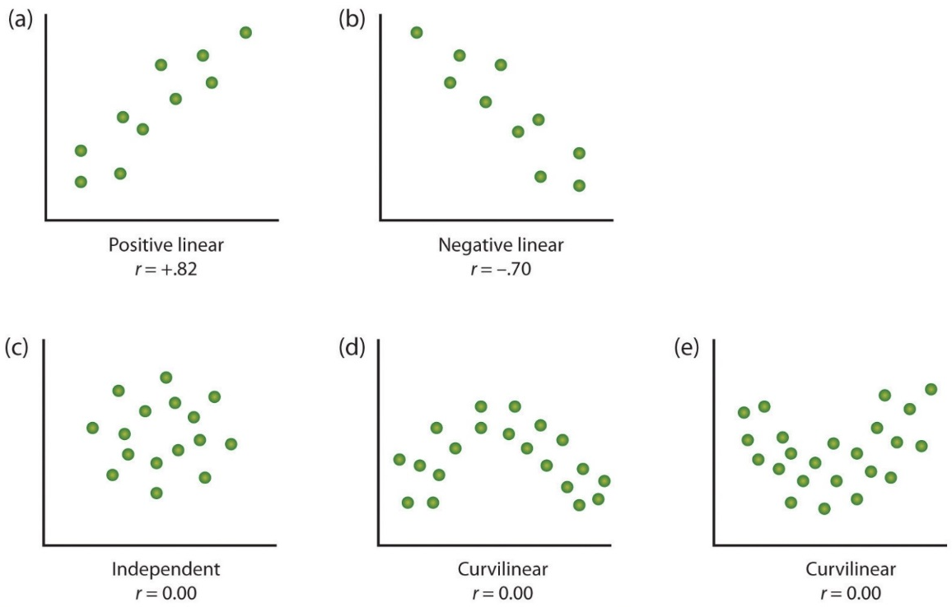
What about non-linear relationships in the data ?
Linear relationships
Lack of linear relationships

Slide 14
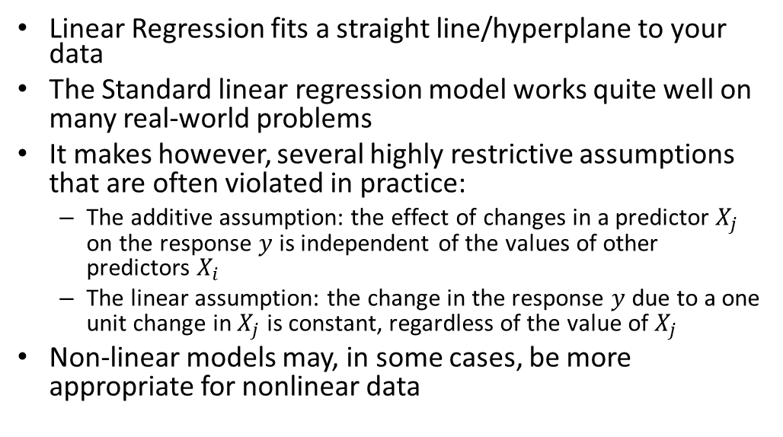
Extensions of the linear model: Non-linear models
Linear Regression fits a straight line/hyperplane to your data
The Standard linear regression model works quite well on many real-world problems
It makes however, several highly restrictive assumptions that are often violated in practice:
The additive assumption: the effect of changes in a predictor $X_{j}$ on the response $y$ is independent of the values of other predictors $X_{i}$
The linear assumption: the change in the response $y$ due to a one unit change in $X_{j}$ is constant, regardless of the value of $X_{j}$
Non-linear models may, in some cases, be more appropriate for nonlinear data

Slide 15
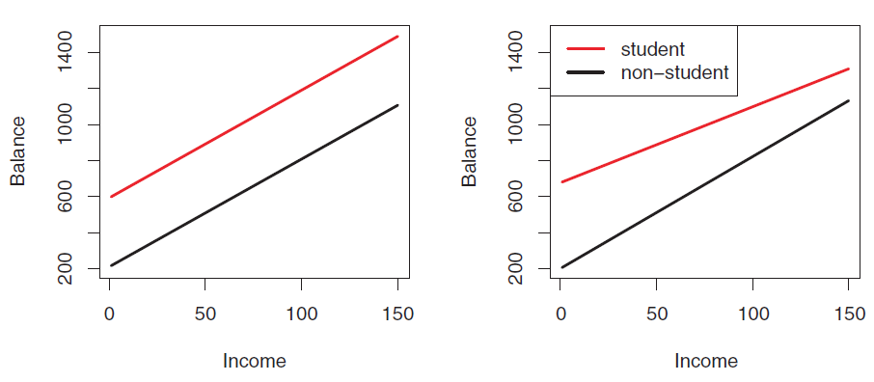
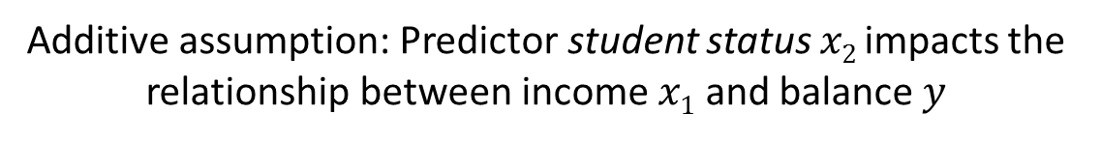
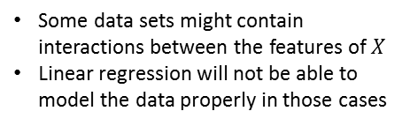


Additive assumption: Predictor student status $x2$impacts the relationship between income $x1$ and balance $y$
Linear regression assumes no interactions between features of $X$
Some data sets might contain interactions between the features of $X$
Linear regression will not be able to model the data properly in those cases
$$y=θ0+θ1x1+ θ2x2$$

Slide 16

The linear assumption does not fit properly Nonlinear relationships

Slide 17



There is a trick though for the linear regression technique to still properly fit nonlinear data:
Polynomial regression through nonlinear transformations
You can still use the linear regression technique to model nonlinear relationships between predictors $X$ and outputs $y$ using the trick of transforming the input features in $X$ using nonlinear transformations
Obviously, a linear model will not properly describe this curvilinear data
Price
(y)
$$y=θ0+θ1x$$
$$X=\left[\begin{matrix}3 \\ 1 \\ \begin{aligned}2 \\ 0\end{aligned}\end{matrix}\right]$$
Size (x)

Slide 18






The trick consists on adding additional artificial features to $X$ formed by nonlinear transformations of the original data features in $X$
Polynomial regression through nonlinear transformations
Nonlinear transformation $Φ$ of input features
$$φ(x)→{x,x}^{2}$$
$$y=θ0+θ_{1}x_{1}+θ2{x_{1}}^{2}$$
Price
(y)
$$X=\left[\begin{matrix}3 \\ 1 \\ \begin{aligned}2 \\ 0\end{aligned}\end{matrix}\right]$$
$$X^{′}=φ(X)=\left[\begin{matrix}3 & 9 \\ 1 & 1 \\ \begin{aligned}2 \\ 0\end{aligned} & \begin{aligned}4 \\ 0\end{aligned}\end{matrix}\right]$$
Size (x)

Slide 19






The more additional artificial features added to $X$ the more complex models we will be able to create
Polynomial regression through nonlinear transformations
Nonlinear transformation $Φ$ of input features
$$φ(x)→{x,x}^{2},x^{3}$$
Price
(y)
$$y=θ0+θ1x_{1}+θ2{x_{1}}^{2}+θ{x_{1}}^{3}$$
$$X=\left[\begin{matrix}3 \\ 1 \\ \begin{aligned}2 \\ 0\end{aligned}\end{matrix}\right]$$
$$X^{′}=φ(X)=\left[\begin{matrix}3 & 9 & 27 \\ 1 & 1 & 1 \\ \begin{aligned}2 \\ 0\end{aligned} & \begin{aligned}4 \\ 0\end{aligned} & \begin{aligned}8 \\ 0\end{aligned}\end{matrix}\right]$$
Size (x)

Slide 20




Polynomial regression through nonlinear transformations
Nonlinear transformation $Φ$ of input features
$$φ(x) →x,\sqrt{x}$$
$$y=θ0+θ1x_{1}+θ2\sqrt{x_{1}}$$
Price
(y)
$$X=\left[\begin{matrix}3 \\ 1 \\ \begin{aligned}2 \\ 0\end{aligned}\end{matrix}\right]$$
$$X^{′}=φ(X)=\left[\begin{matrix}3 & \sqrt{3} \\ 1 & \sqrt{1} \\ \begin{aligned}2 \\ 0\end{aligned} & \begin{aligned}\sqrt{2} \\ \sqrt{0}\end{aligned}\end{matrix}\right]$$
Size (x)
Important: You still apply a linear regression model to the nonlinearly transformed input features, but because you are doing that in a higher dimensional space, the resulting hyper plane will probably work well if your data is not too pathological

Slide 21
Feature scaling
Feature scaling is a method used to standardize the range of independent variables or features of data
It is also known as data normalization and is generally performed during the data preprocessing step.
Since the range of values of raw data varies widely, in some machine learning algorithms, objective functions will not work properly without normalization.
The majority of classifiers calculate the distance between two points using the Euclidean distance, if one of the features has a broad range of values, the distance will be governed by this particular feature
Therefore, the range of all features should be normalized so that each feature contributes approximately proportionately to the final distance
Size (feet²) | Number of bedrooms | Number of floors | Age of home (years) | Price ($1000)
2104 | 5 | 1 | 45 | 460
1416 | 3 | 2 | 40 | 232
1534 | 3 | 2 | 30 | 315
852 | 2 | 1 | 36 | 178
… | … | … | … | …

Slide 22







Feature Scaling: Make sure features are on a similar scale
Without feature scaling
With feature scaling
$x_{1}$= number of bedrooms (1-5)
$x_{2}$= size (0-2000 feet²)
$$z1=\frac{x1 (number of bathrooms)}{5}$$
$$z2=\frac{x2 (size)}{2000}$$
$$0≤{z≤1}$$
Pathological trajectory of gradient descent
Easy trajectory for gradient descent

Slide 23






There are many techniques to do Feature scaling: rescaling, centering, standardization and normalization to unit length
Rescaling
To range in [-1,1] or [0, 1]
Centering
To mean 0
Normalization/Standardization
zero-mean (when subtracting the mean in the numerator) and unit-variance. Widely used for normalization in many machine learning algorithms
Normalization to unit length
the converted vector $\hat{z}$ has length one
$$\hat{z}=\frac{x−min⁡(x)}{\max\left(x\right)−min⁡(x)}$$
$$\hat{z}=\frac{x}{\max\left(x\right)}$$
$\hat{z}=$ $x−μ$
$$\hat{z}=\frac{x−μ}{σ}$$
$$\hat{z}=\frac{x}{\left\|x\right\|}$$

Slide 24





Features scaling: centering and normalization
$$zn=x_{n}−\overline{x}$$
$$zn=\frac{xn−\overline{x}}{σn}$$

Slide 25













Is this stuff actually useful? Yes, companies use linear models all the time to optimize decision-making
There are all sorts of cool applications of multivariate linear regression: One I find particularly interesting is Gaze estimation
$$X$$
$$yxs$$
$$yys$$
$$ye$$
$$xe$$
$$θ={{(X}^{T}X)}^{−1}X^{T}y$$
$$y=θ0+θ_{1}x_{1}+θ_{2}x_{2}$$

Slide 26
References
https://www.coursera.org/learn/machine-learning

